Slide 1









WEATHER FORECAST
SON YELENA

Slide 2

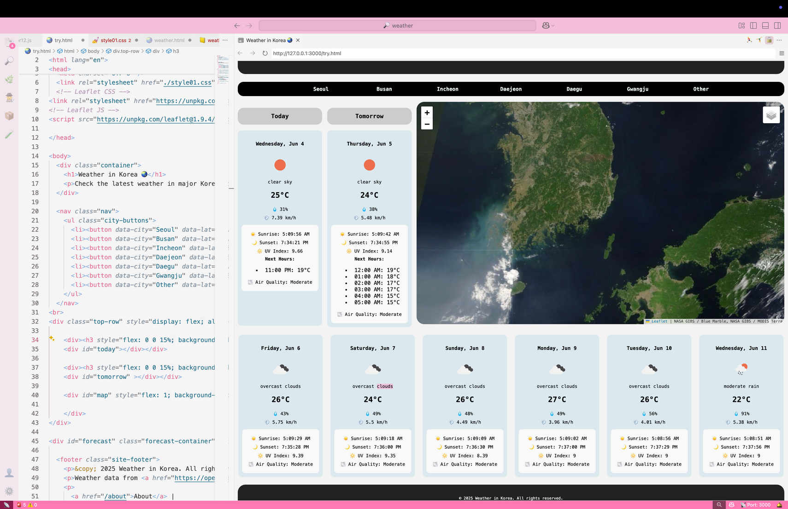



USER INTERFACE OVERVIEW
Intuitive layout with Today, Tomorrow, and Map sections side-by-side
Weather cards with detailed hourly forecasts for the first two days

Slide 3


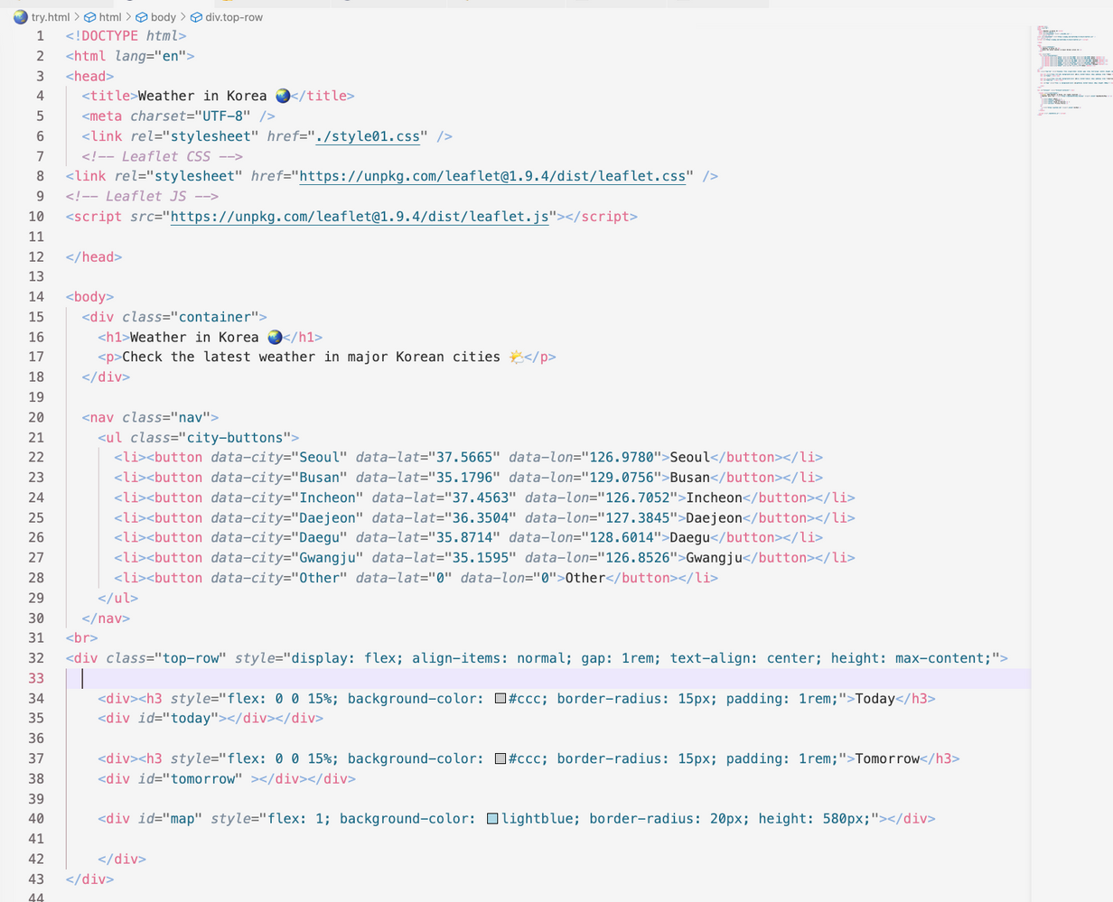

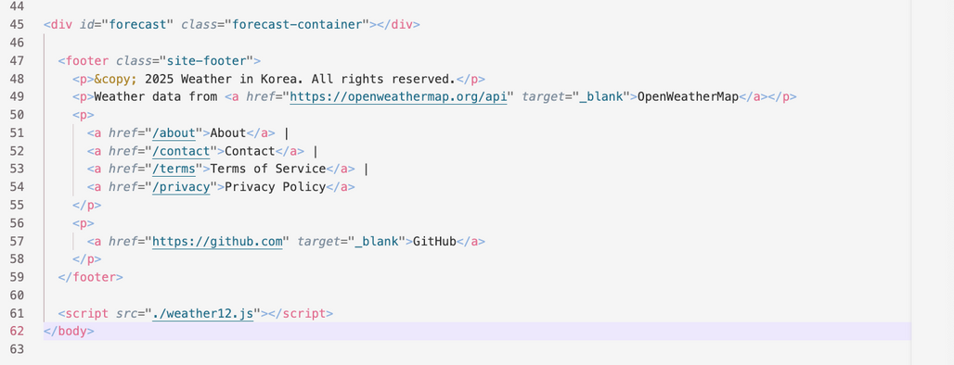
HTML

Slide 4


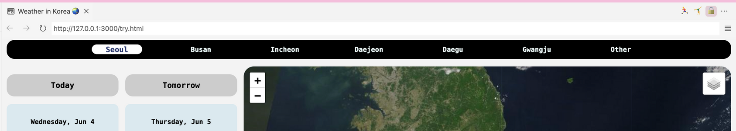

REAL-TIME WEATHER AND SATELLITE IMAGERY TAILORED FOR YOUR CITY
detailed weather forecasts for today and tomorrow
NASA’s satellite imagery with interactive map layers
seamless switching between cities with a single click

Slide 5
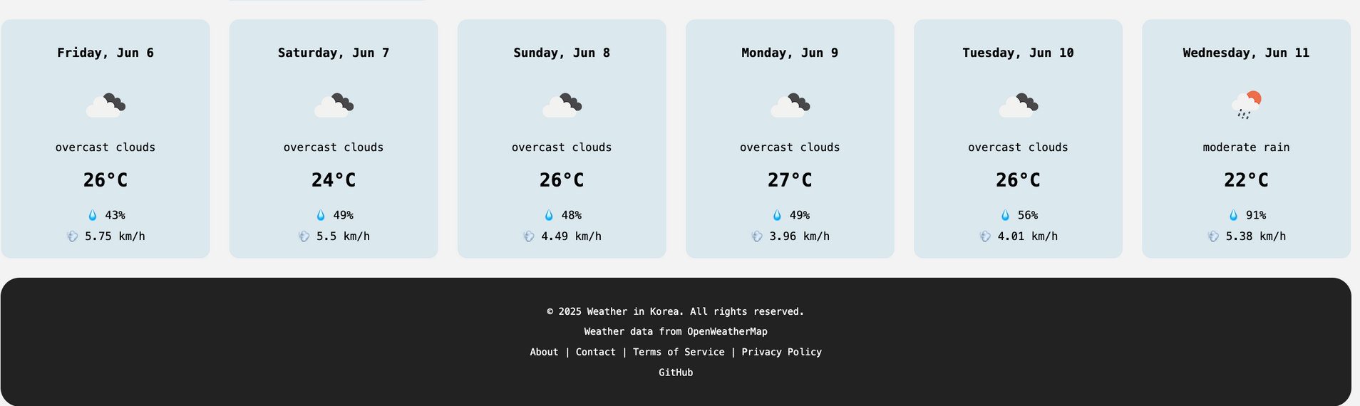
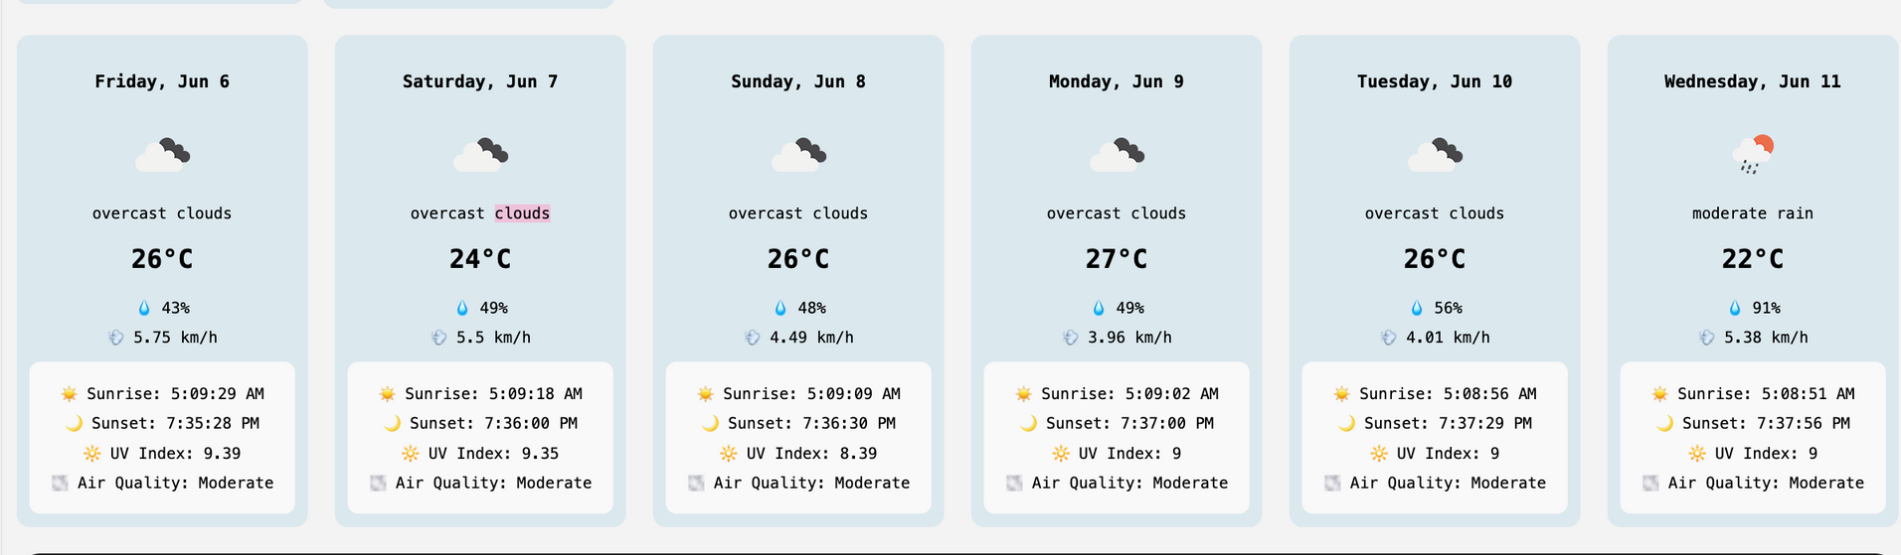
WEATHER DETAILS

Slide 6
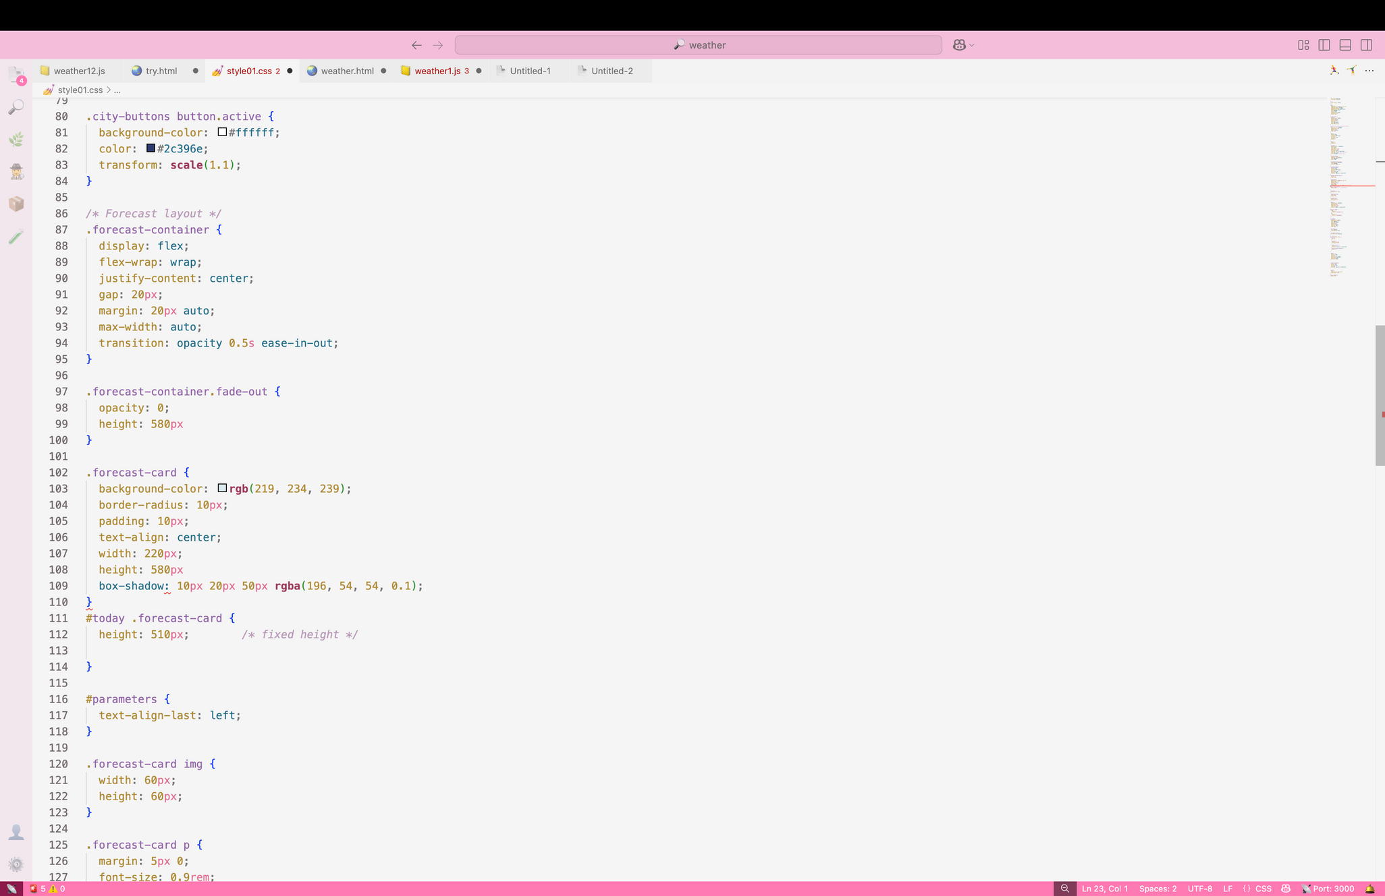
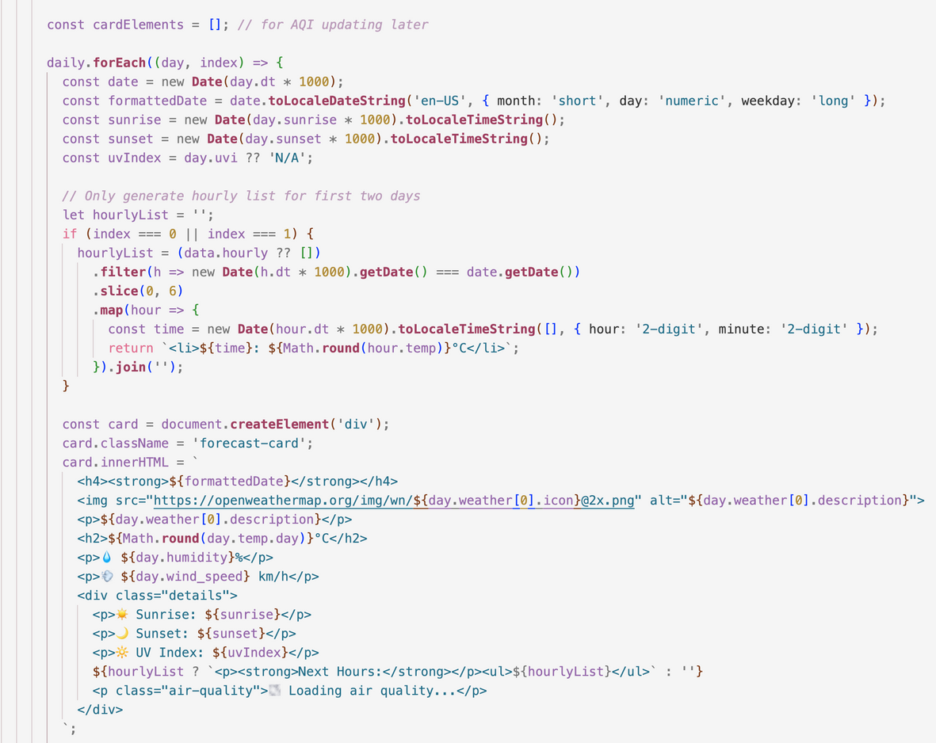



CSS
JS

Slide 7


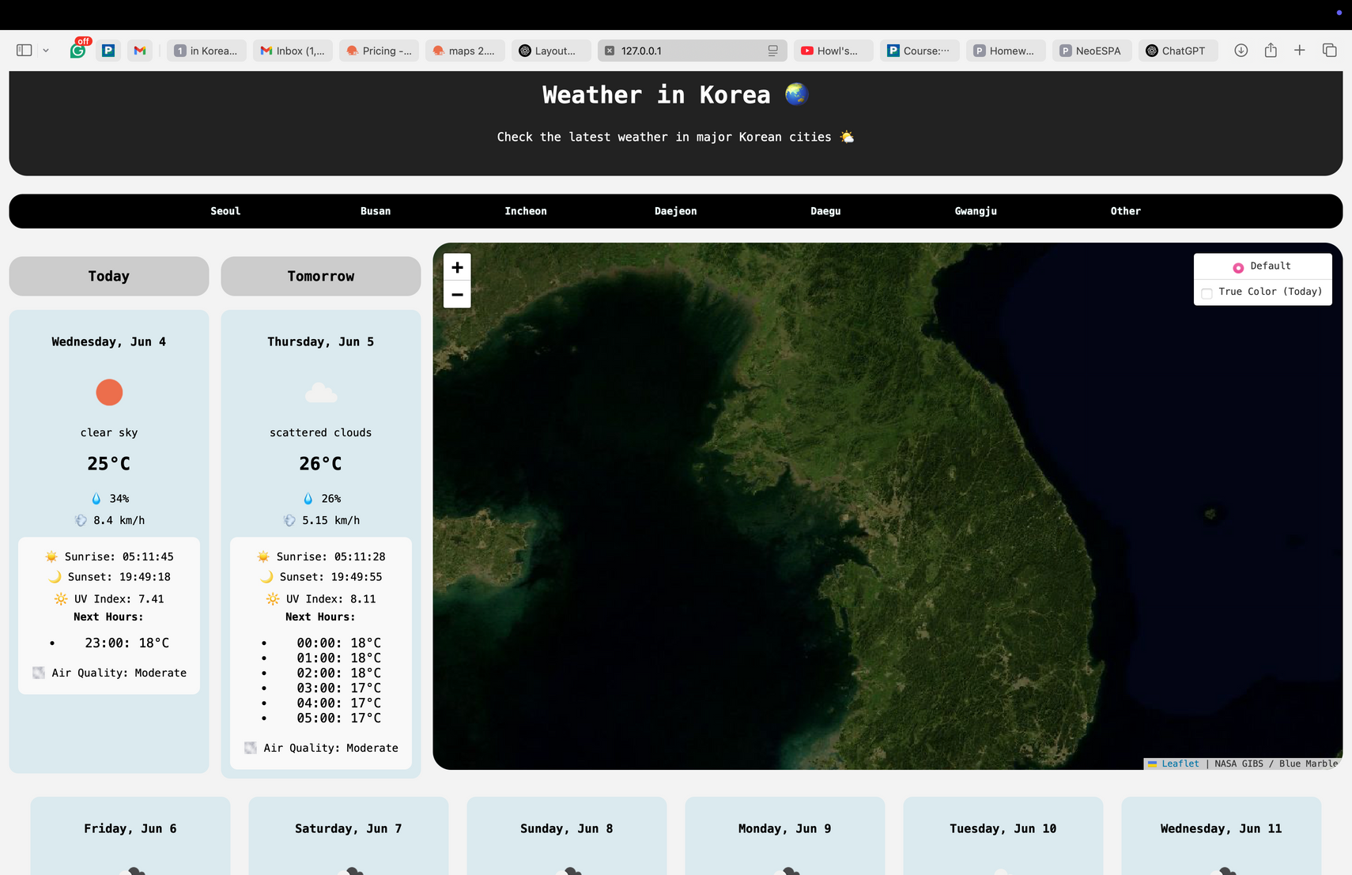
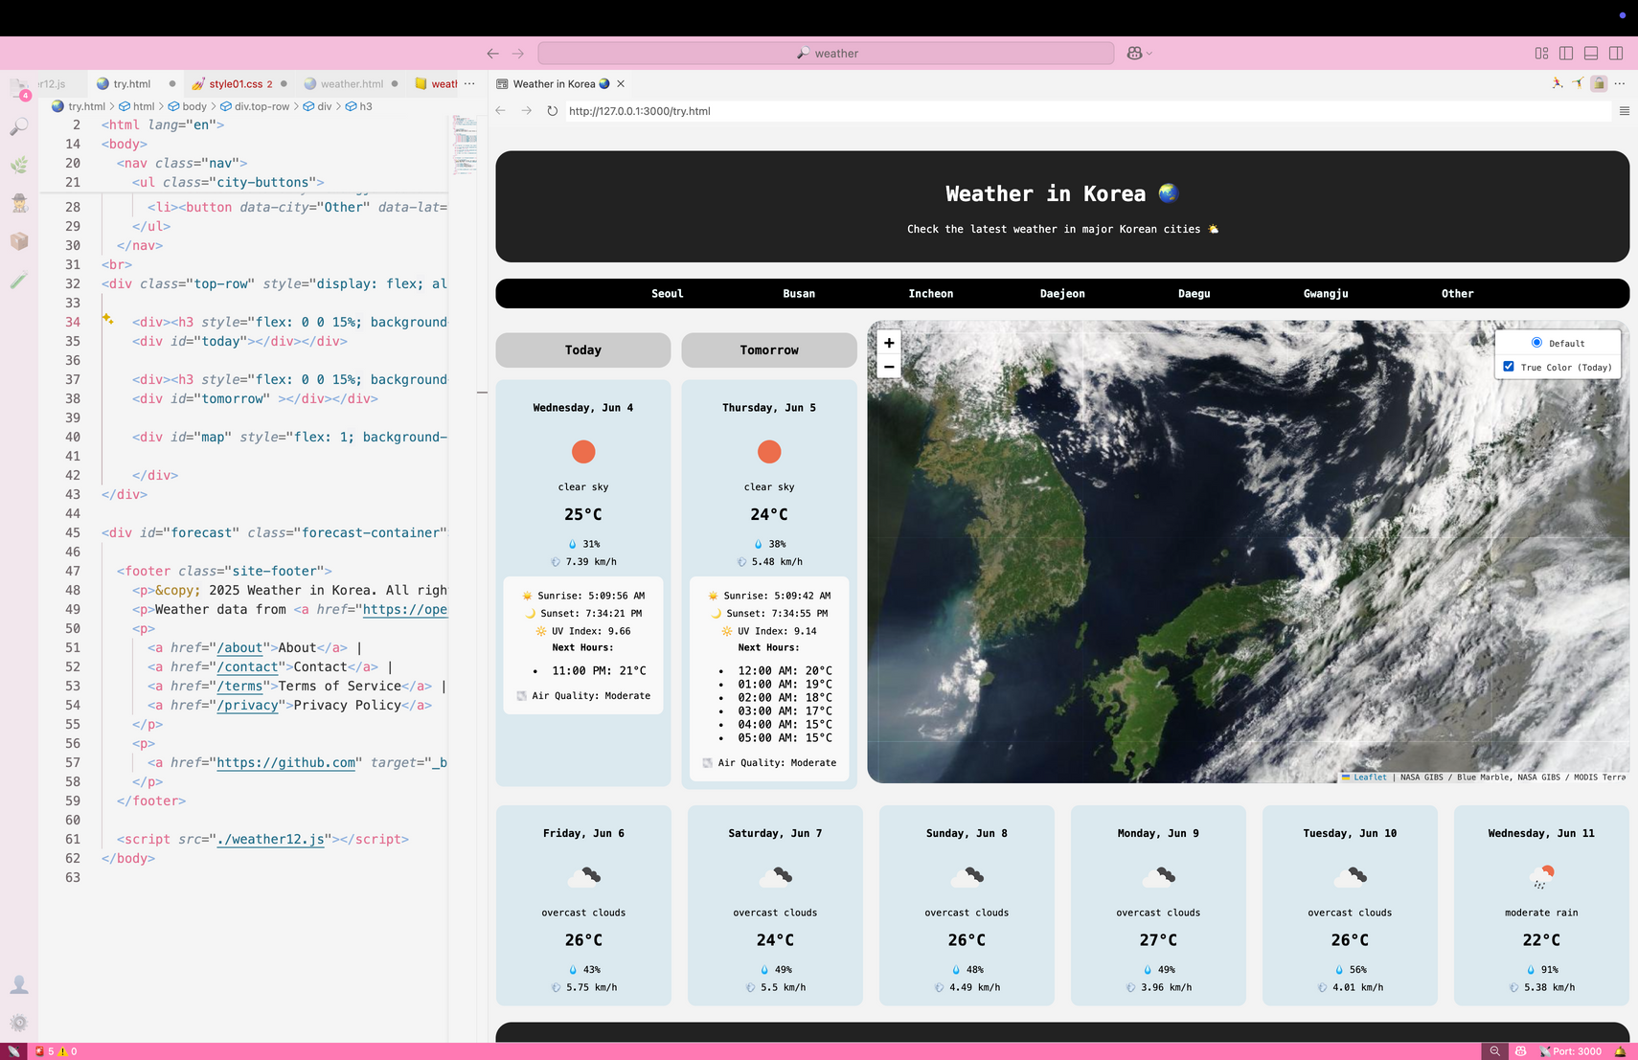

INTERACTIVE MAP
Base map with NASA’s Blue Marble satellite imagery
Overlay true-color imagery updated daily
Layer controls for easy switching on/off
Zoom and pan to explore your city and surroundings

Slide 8
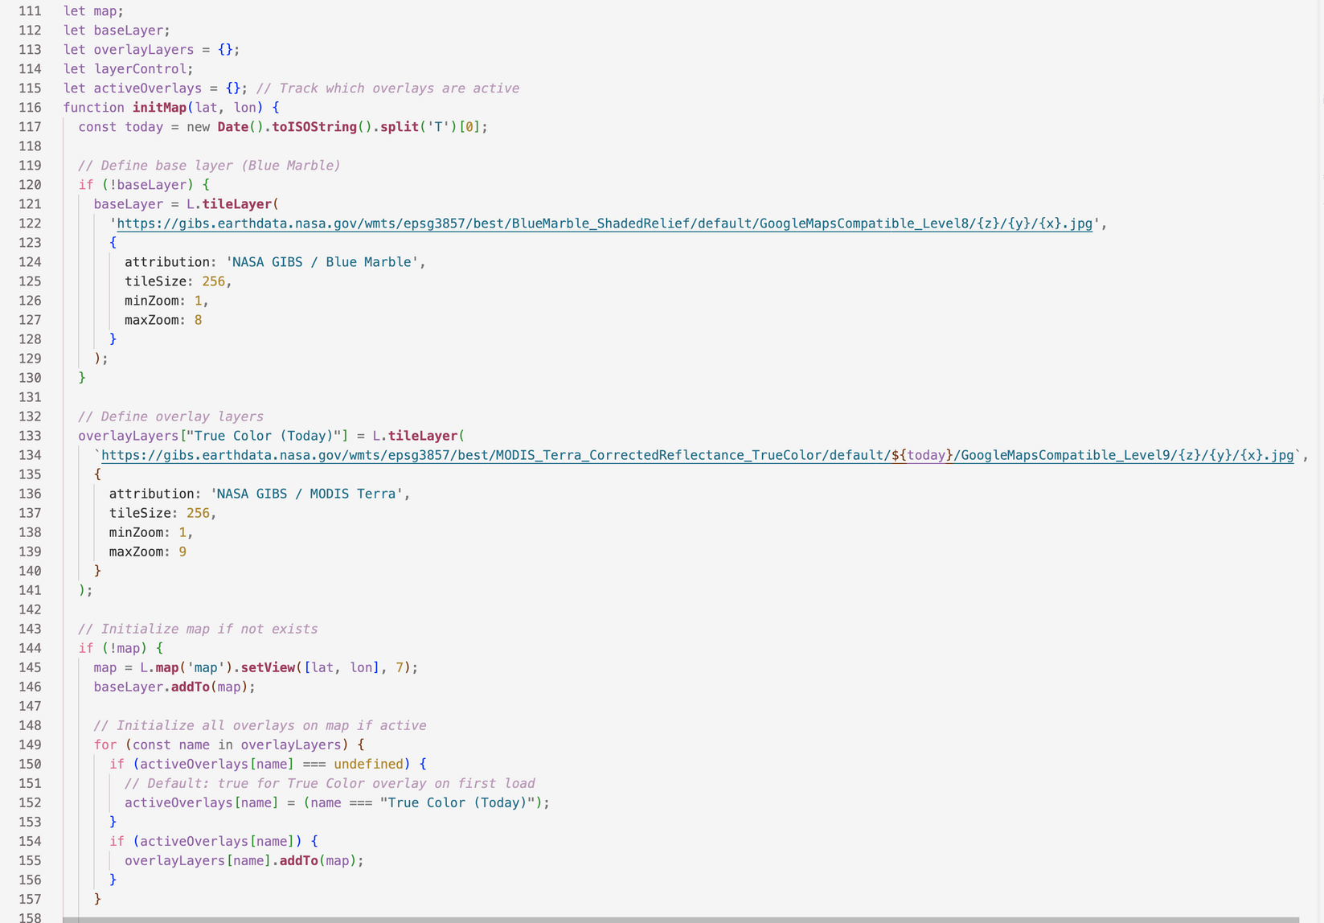



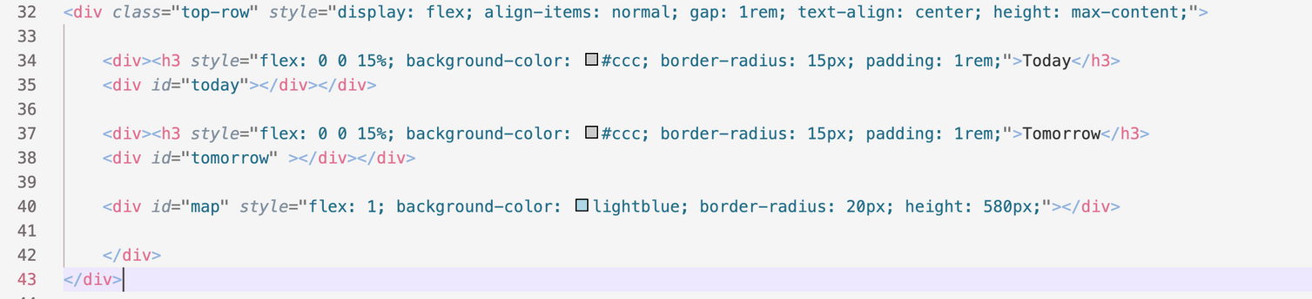



JS
HTML

Slide 9




PROCESS
Uses OpenWeatherMap API for accurate weather and air quality data
NASA GIBS WMTS service powers high-res satellite imagery
Leaflet.js for a smooth and interactive map experience
JavaScript logic loads data and updates UI dynamically

Slide 10
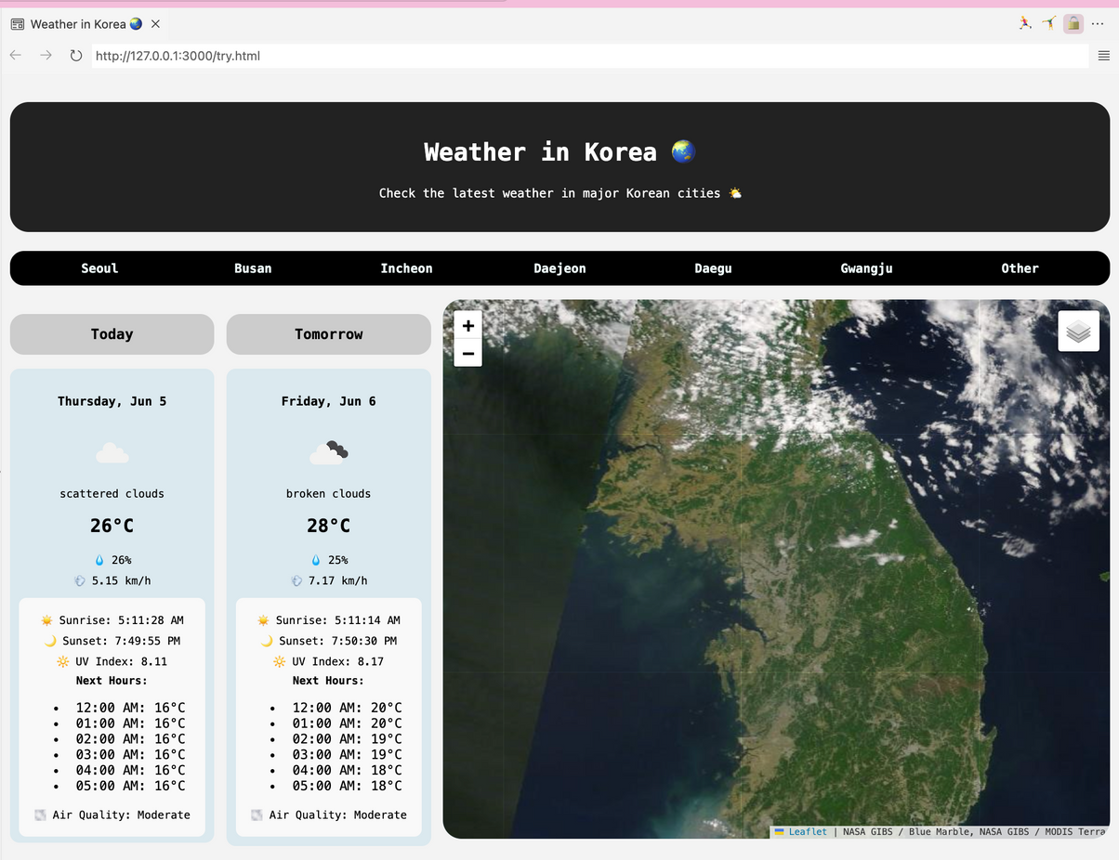
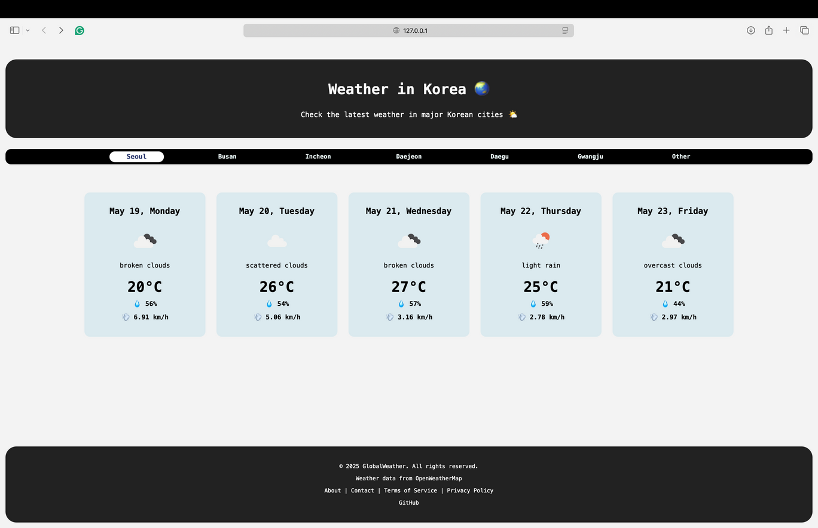
BEFORE
NOW

Slide 11




THANK YOU FOR PLAYING!

